Slide 1

LLM-FIne Tuned Financial Advisor
Northeastern University
DS5500: Data Science Capstone
P2 Preliminary Presentation
Laasya Anantha Prasad
Krishna Venkatesh
Rakshak Kunchum

Slide 2
Background
Scope : Creating a dynamic, real time personal finance advisory tool to overcome limitations of traditional methods.
Datasets Used : Financial Alpaca Dataset (Stanford Alpaca dataset + the Financial Q&A (FIQA) dataset + GPT 3.5 generated data) and FinTalk-19k Dataset from Hugging Face.
Goal & Outcome: Democratized web app for convenient access and personalized support for credit, budgeting and investments

Slide 3

What is our Project and what has been done?
Gaps in Personal Finance : Traditional tools struggle with modern financial needs and complexity.
LLM based Financial Solution: Real-time insights powered by AI and LLM’s. Access anywhere, efficient and convenient.
Training Features:
Instruction (Question), Context, Response (Answer)

Slide 4
Dataset Description
Dataset columns | Data type | Description | Data Example
Instruction | String | The question or topic of the conversation. | What can I do to raise my credit score after Discover closed my account due to a fraudulent charge and my score dropped 70 points?
Context | String | Background or additional details about the conversation. | You've had a Discover card for six years without issues. Recently, you noticed three $100 charges from gas stations in a state you’ve never visited. Discover helped you dispute the charges but closed your account, leading to a 70-point drop in your credit score.
Response | String | The answer or information provided in response. | If you believe the fraudulent charge was not your fault, you may be able to dispute the account closure with Discover and have the negative impact on your credit score reversed. You can call Discover's customer service and explain the situation, asking them to reopen the account and issue a new card. Additionally, you can try to rebuild your credit score by applying for a few cards now to avoid taking another average age hit in the future.
Tag | String | Category label for the conversation. | Personal Finance
Text | String/Null | Empty column mostly, hence dropping. | NA

Slide 5
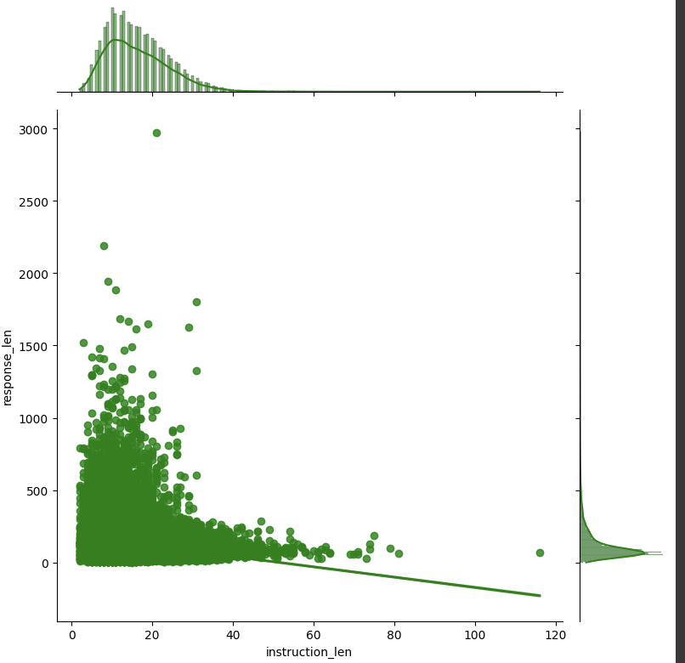
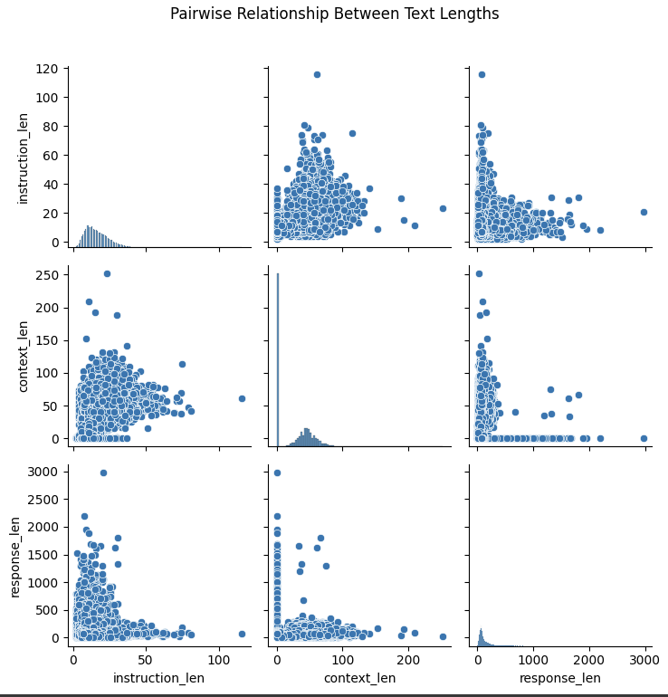
Phase 1 EDA Results
Longer instruction lengths does not lead to longer response length as shown by pearson correlation value (-0.17) and plot.
Plots indicate that instruction length, context length and response length are slightly or not correlated.

Slide 6
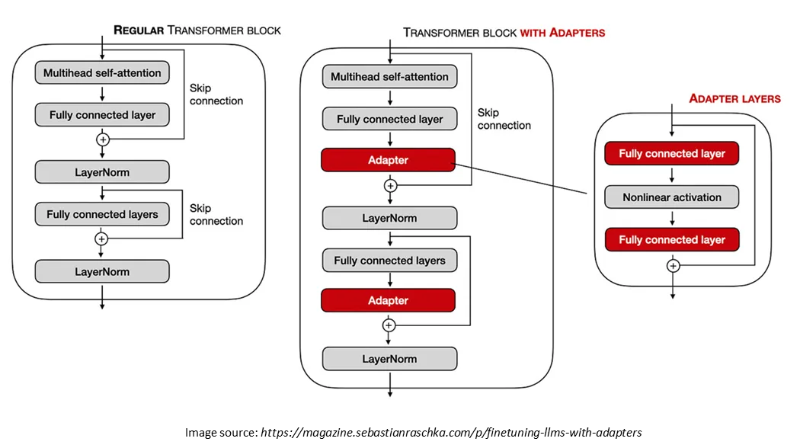
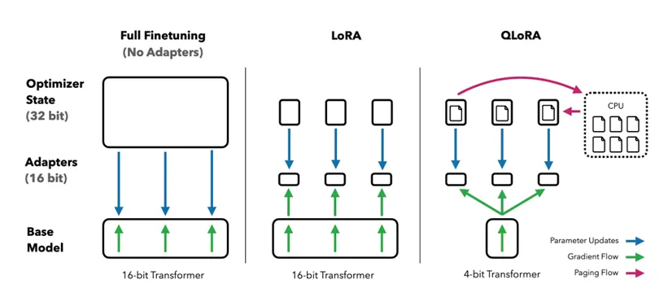
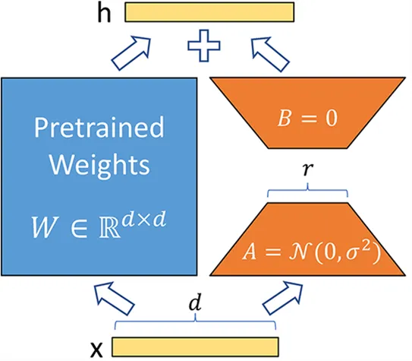
Fine Tuning Training Methodology: Parameter Efficient Fine Tuning
We are using PEFT with QLoRA configuration with 8-bit precision to adaptively fine-tune a causal language model by applying low-rank matrix adaptations on the 'q_proj' and 'v_proj' modules, optimizing memory and computational efficiency for training on limited VRAM.
(QLORA: Efficient Finetuning of Quantized LLMs)

Slide 7
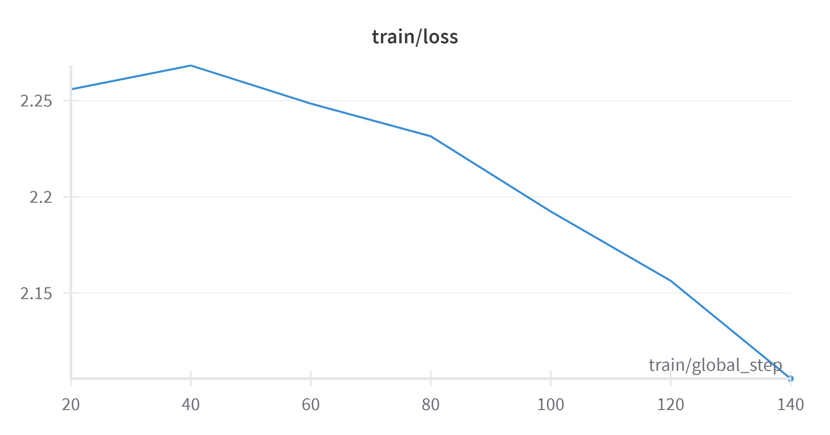
Results of Phase 1
4-6*
SOTA Perplexity LlaMA Model Scores
7.12
Current Fine tuned LlaMa Perplexity model scores
LlaMA 7B fine-tuning
(* Revolutionizing Financial Insights with Llama-3-70B)
‹#›

Slide 8
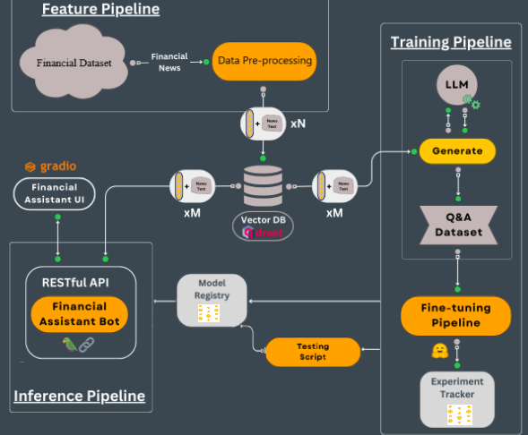
Steps AND milestones in P2
Feature Pipeline:
Completed
Training Pipeline & Model Fine-tuning:
LlaMA Fine Tuning - Completed
Mistral Fine Tuning - Completed
Vector data Pipeline:
* final stage - Expected by Nov 26
Inference Pipeline:
Model Inference - Completed
API Development - Pending, Expected by Nov 26
Financial Advisor UI - Pending, Expected by Dec 1
‹#›
LLMs kit: Build a production-ready real-time financial advisor

Slide 9
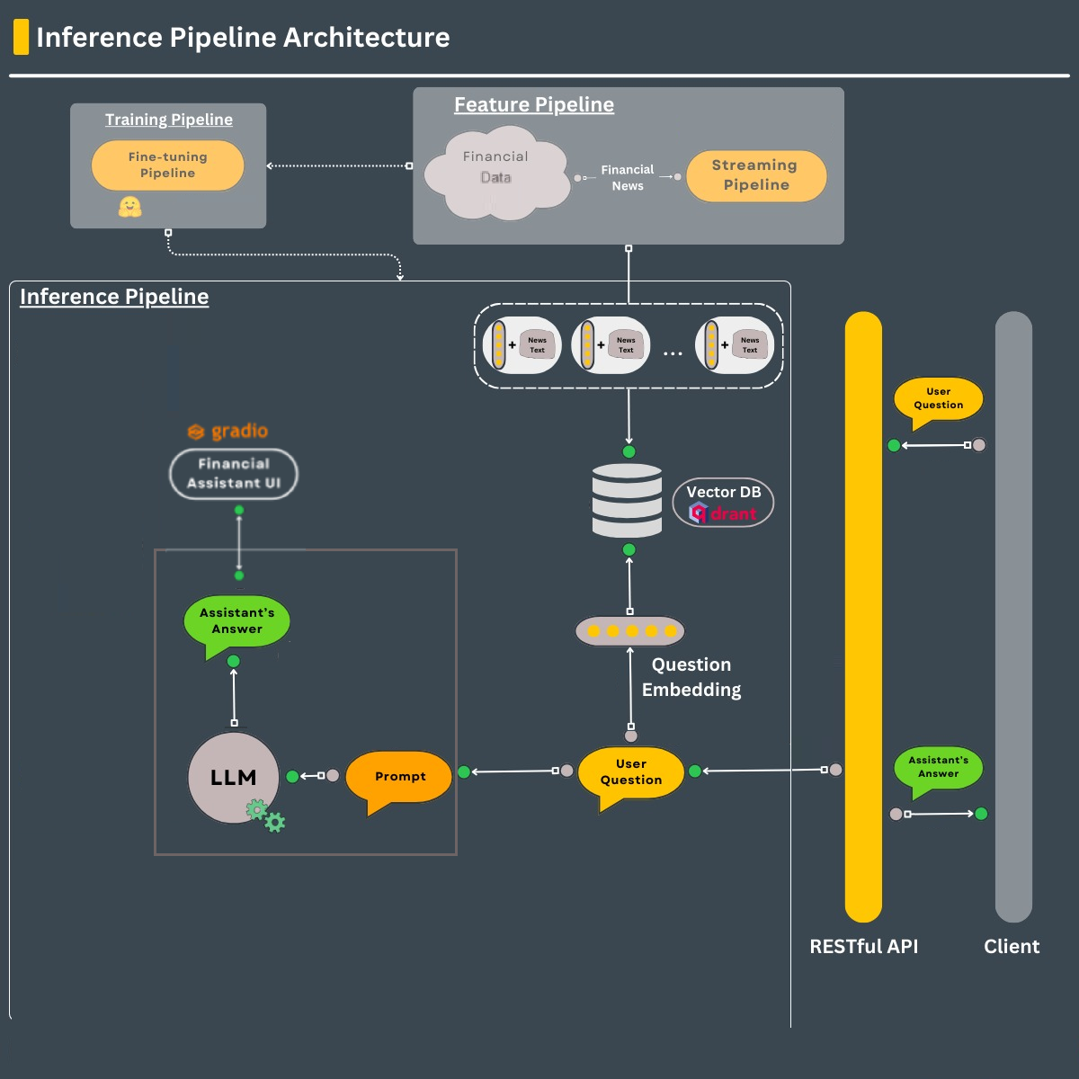
Model Inference pipeline
Inference Pipeline: Transforms user questions into embeddings, retrieves relevant data from a vector database, and generates answers using a language model (LLM).
Integration: Connects with a RESTful API to provide seamless interaction between the financial assistant UI and the client.
LLMs kit: Build a production-ready real-time financial advisor
‹#›

Slide 10
Fined tuned llama Model is generating clear and succinct financial advice
Instruction | Fine Tuned Llama Response
When should I get a second credit card? | You can apply for your first credit card when you are 18 years old and have steady income, such as from employment or investments. You may also be able to qualify if you're married or live with someone who has good credit history. If you don’t meet these requirements yet, it might make sense to wait until you do before applying for another credit card.
Tell me about the risks in money market accounts? | Money Market Accounts are considered to be one of the safest investments available today, but they do have some risk factors associated with them. The first and most important thing you need to know when it comes to MMA's is that there is no guarantee on your principal amount invested. Another risk factor is liquidity. Since these types of accounts typically offer lower yields than other savings vehicles such as CD's, you may find yourself wanting access to your funds before maturity date. In this case, you would likely face penalties for early withdrawal.
‹#›

Slide 11
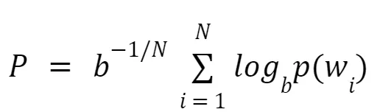
Standard Natural Language Evaluation Metrics are not appropriate for LLM generated Financial advice
Perplexity measures how well a language model predicts word sequences. Lower perplexity indicates better fluency and natural language alignment.
Challenge with ROUGE Evaluation:
The dataset includes advice from authorized financial experts on Reddit, which often includes conversational elements.A direct ROUGE score comparison between dataset responses and model-generated responses may not be appropriate due to the conversational nature of the advice.
Perplexity
Custom Heuristics Evaluation:
Clarity Evaluation
Specificity Evaluation
Relevance Evaluation
‹#›

Slide 12
Case by case analysis of custom heuristic evaluation metrics
Instruction | Context | Dataset Response | Model Response
How do I find a good mutual fund to invest 5K in with a moderately high amount of risk? | NA | Vanguard has a lot of mutual fund offerings. (I have an account there.) Within the members' section they give indications of the level of risk/reward for each fund. | The best way for you to invest $5000 is to take advantage of your employer's retirement plan, which will allow you to set aside money tax-free and automatically have it invested into funds based on your age and goals. If your company does not offer this benefit, then you should look at Vanguard (VG) or Fidelity (FD). These are two large discount brokerage firms that have low fees and offer great diversification by owning a variety of stocks and bonds rather than just one or two mutual funds. Both companies provide online tools where you can create an account and start investing immediately. Good luck!
ROUGE-L Score | Clarity Evaluation | Specificity Evaluation | Relevance Evaluation
0.139 | 0.0 | 0.5 | 0.129
‹#›

Slide 13
Case by case analysis of custom heuristic evaluation metrics
Instruction | Context | Dataset Response | Model Response
What are your thoughts on using pay later and payday lenders, and do you think they are out of control? | The writer is walking to the train station and notices multiple ads for pay later and payday lenders, which prompts them to express their concerns about the services. | The writer is concerned about the prevalence of pay later and payday lenders and their potential to lead people into debt for discretionary spending. They personally use Zip Pay to spread out their expenses and find it helpful for their mental health, but acknowledge that these services can be risky if not used responsibly. | I feel like pay later and payday lending companies should be heavily regulated as they can take advantage of people in need. In addition, it seems like many borrowers use these services more than once or twice per year, so they could easily end up in debt if they aren't careful. It also makes me nervous how easy it appears to get approved; anyone who has any kind of credit score can probably qualify.
ROUGE-L Score | Clarity Evaluation | Specificity Evaluation | Relevance Evaluation
0.189 | 0.62 | 0.667 | 0.193
‹#›

Slide 14
Questions?
ThanK YoU

